Slide 1
Project Proposal
2020. 05. 04.
Kyuyeon Kim, Hyeongyeol Ryu, Yeonjae Kim
Notes:
Hello every one, this is our project proposal for cs570,
Our name is Kyuyeon Kim, Hyeongyeol Ryu, and Yeonjae Kim.

Slide 2
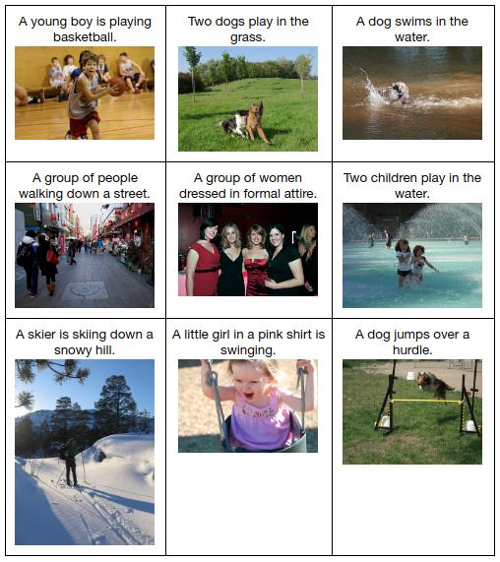
Cross-modal learning
Image
Audio
Text
Learning with data having different sources
Example of cross-modal learning: Image captioning
Notes:
Up to now, people try to train machine learning models across various sources of data such as image, audio and text
and we call this, cross modal learning.
The famous example of cross-modal learning is image captioning as shown on the left side.
There are many works these days to jointly use the image data together with audio or text data.

Slide 3
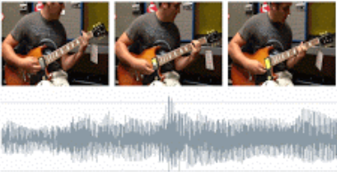
Limitation of cross-modal learning works
Many works use supervised learning – use labeled dataset.
Or use teacher-student supervision.
Teacher Network
Already pretrained on large dataset,
such as ImageNet.
Acoustic guitar
OK, I will learn to classify this sound as an acoustic guitar.
Student Network
Video playing acoustic guitar
Notes:
However, there are some limitations of existing works.
They tend to use labeled dataset for supervised learning, or instead commonly used teacher-student supervision.
For instance, a “teacher” vision network trained on large labeled dataset such as ImageNet, can be used to annotate frames of a YouTube video as “acoustic guitar”,
which provides training data to the “student” audio network for learning what an “acoustic guitar” sounds like.

Slide 4
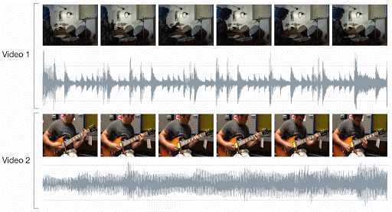
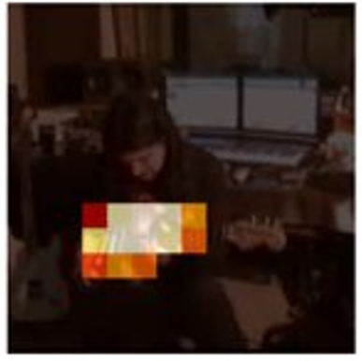
Self-supervised audiovisual learning
Video automatically has the information about the correspondence.
Learning the correspondence leads to enabling the sound localization on the image.
In which part of the image makes sound?
Correspondence: Does this image matches to the video frame?
Notes:
Recently, people are trying to train both cross-modal in self-supervised manner, in terms of audio and visual data.
They create true and false samples utilizing the correspondence between video frames and audio,
then train the networks to learn the audiovisual correspondence from scratch.
As described below, this process also enables network to localize the object that makes the sound.

Slide 5
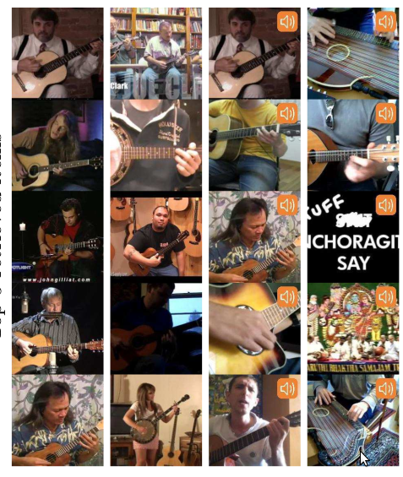
Related Works (1) – Objects that Sound (ECCV 2018)
Cross-modal retrieval (e.g. audio query → retrieve images which are related to it).
Sound source localization
Given query
Retrieved
items
Sound source localization
Cross-modal retrieval
Notes:
This is the first paper we selected for the replication.
There are two main goals in this paper.
One is cross-modal retrieval. For example if we give audio sample query to the network, the network can retrieve images which are likely to make that sound.
The other one is sound source localization, the network can highlight the objects that make sound in the image.

Slide 6
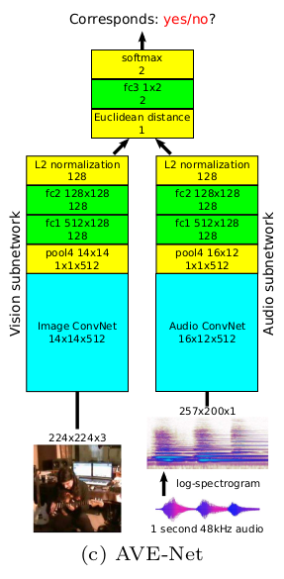
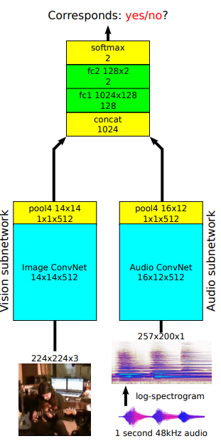
Related works (2) – Look, Listen and Learn (ICCV 2017)
Fuse the image and audio features by just concatenating.
Did not target cross-modal retrieval.
Objects that Sound
(first paper)
Look, Listen and Learn
(second paper)
Notes:
This is the second related work of audiovisual cross-modal learning.
This is also a previous work of author in the first paper I mentioned earlier.
There is a slight difference in the model in this paper,
Fuse ~~

Slide 7
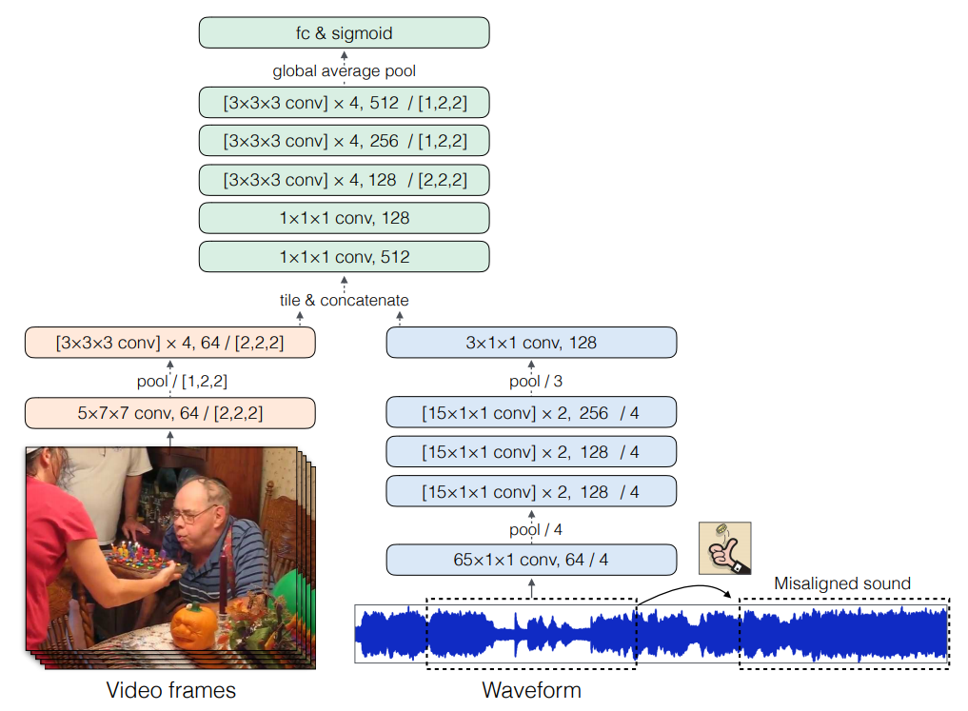
Related works (3) – Audio-Visual Scene Analysis with Self-Supervised Multisensory Features (ECCV 2018)
Use multiple video frames as and visual network input. (First paper used only single frame.)
Use 3D convolution on video frames.
(First paper used only 2D convolution.)
Use raw sound data as an input.
(First paper changes sound data into the spectrogram)
Notes:
The third related work is the concurrent work of audiovisual learning in ECCV 2018.
세가지 말하기.

Slide 8
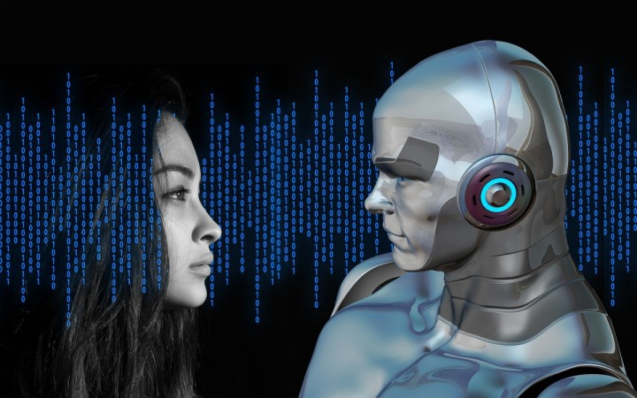


Why do we select “Objects That Sound” ?
Processing video data will give us good experience.
We don’t have any experience of using video data to train a deep neural network.
Training the model to learn the semantic information from scratch with both visual and audio data seems to be a novel topic.
It would also be beneficial for our research in that this paper’s idea can be extended to many other domains hard to solve.
Notes:
We selected to replicate ‘Objects that sound’. The reason we chose this paper is that actually our team members have no experience using video data for neural networks.
It’ll be very meaningful to learn this. And more importantly, Among the three works we showed, this proposed the most novel idea which can be extended to many other domains and showed state of the art performance.

Slide 9
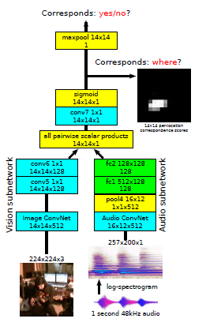
Replication approach
Mainly implement AVE-Net / AVOL-Net with video/audio dataset.
AVE-Net : Learns the correspondence between image and audio.
AVOL-Net : Localizes a sound source on the image.
AVE-Net
AVOL-Net
Notes:
As you can see our main job is to implement neural networks. AVE-Net the left one learns the correspondence between vision and sound. AVOL-Net the right one finds out where the sound source is on the image.

Slide 10
Improvement approach
Limitations : Dataset only for musical instruments
Notes:
In this paper, authors suggested novel network architectures which can be trained for multi-modal retrieval and localizing the sound source in an image.​
However, there still exists some limitations that the objects they used are only targeted to musical instrument, which is very limited domain objects and showed no improvements to other tasks.​

Slide 11
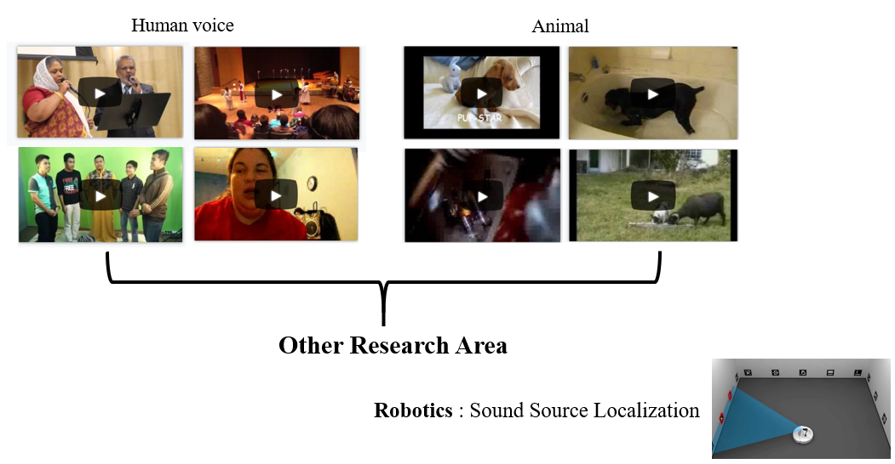
Utilize different object classes
Notes:
For this reason, in this project we try to utilize a different object classes that can be extended to real world applications;​ Human talking, singing.
We believe this approach can make a first step to solving many other hard tasks. For example, sound source localization(SSL): traditional tricky problems in robotics.​

Slide 12
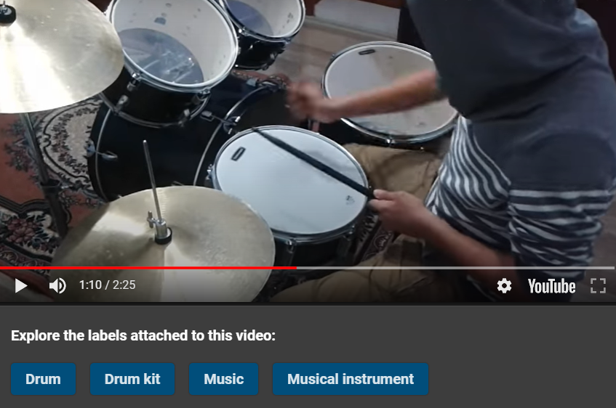
Dataset
Original dataset: AudioSet
Consist of 10 second video clips from YouTube + audio class labels
Used subset of dataset for replication
  Musical instrument: guitar, drum, violin, …
Improving by utilizing other object classes
  Human voice, animal
Example of AudioSet
Notes:
Now let me introduce what data we will use.
We are going to use 'AudioSet'. It consists of ten seconds of video clips from youtube with audio class labels.
To make the dataset more manageable and interesting for the purposes, we will only deal with the classes related to musical instruments.
For improving our implementation, we will try another classes, such as human voice and animal

Slide 13
Plan
5/4
Project Proposal
5/18
5/29
6/1
Progress Update
6/8
6/14
6/29
Final Presentation
Data Preprocessing
Improvement
Final
- Collecting: A
- Classifying: B
- Preprocessing: C
- Different data: A
- Hyper-parameter: B
- Modify model: C
- Writing paper
- Preparing ppt
- Recording video
Model Replication
Experiment & Comparison
- Vision Subnetwork: A
- Audio Subnetwork: B
- Main Network: C
- Experiment I (replication vs comparison): A
- Experiment II (replication vs improvement): B
- Plotting & Data Analysis: C
A : Kyuyeon Kim
B : Hyeongyeol Ryu
C : Yeonjae Kim
Notes:
This is our plan.
Until May 18th, we will focus on data collecting and preprocessing.
After that, we will be ready to replicate the proposed model.
The proposed model is composed of vision subnetwork, audio subnetwork, and main network.
We will be in charge of each network. And there might be some time for preparing progress update.
After the progress update, we will try to improve the model,
such as using different data, tuning hyperparameter, and modifying the model.
And next two weeks, we will compare the replication model with two comparison models, also with improvement, too.
During the last 2 weeks, we will prepare our final report and presentation.

Slide 14
Thank you
Notes:
Thank you for listening. If you have any questions, feel free to leave comments under the video.

